Slide 1
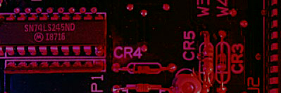
Summary
Signed Binary Numbers
There are several ways to represent signed binary numbers. In all cases, the MSB in a signed number is the sign bit, that tells you if the number is positive or negative.
Computers use a modified 2’s complement for signed numbers. Positive numbers are stored in true form (with a 0 for the sign bit) and negative numbers are stored in complement form (with a 1 for the sign bit).
For example, the positive number 58 is written using 8-bits as 00111010 (true form).
Sign bit
Magnitude bits

Slide 2
Summary
Signed Binary Numbers
Negative numbers are written as the 2’s complement of the corresponding positive number.
The negative number −58 is written as:
−58 = 11000110 (complement form)
Sign bit
Magnitude bits
An easy way to read a signed number that uses this notation is to assign the sign bit a column weight of −128 (for an 8-bit number). Then add the column weights for the 1’s.
Example
Assuming that the sign bit = −128, show that 11000110 = −58 as a 2’s complement signed number:
Solution
Column weights: −128 64 32 16 8 4 2 1.
1 1 0 0 0 1 1 0
−128 +64 +4 +2 = −58

Slide 3
Summary
Floating Point Numbers
Floating point notation is capable of representing very large or small numbers by using a form of scientific notation. A 32-bit single precision number is illustrated.
S E (8 bits) F (23 bits)
Sign bit
Biased exponent (+127)
Magnitude with MSB dropped
Example
Express the speed of light, c, in single precision floating point notation. (c = 0.2998 x 10⁹)
Solution
In binary, c = 0001 0001 1101 1110 1001 0101 1100 0000₂.
In scientific notation, c = 1.001 1101 1110 1001 0101 1100 0000 x 2²⁸.
S = 0 because the number is positive. E = 28 + 127 = 155₁₀ = 1001 1011₂. F is the next 23 bits after the first 1 is dropped.
In floating point notation, c =
0 10011011 001 1101 1110 1001 0101 1100

Slide 4
Summary
Arithmetic Operations with Signed Numbers
Using the signed number notation with negative numbers in 2’s complement form simplifies addition and subtraction of signed numbers.
Rules for addition: Add the two signed numbers. Discard any final carries. The result is in signed form.
Examples:
00011110 = +30
00001111 = +15
00001110 = +14
11101111 = −17
11111111 = −1
11111000 = −8
00101101
= +45
11111101
= −3
1
11110111
= −9
Discard carry

Slide 5
Summary
Arithmetic Operations with Signed Numbers
Note that if the number of bits required for the answer is exceeded, overflow will occur. This occurs only if both numbers have the same sign. The overflow will be indicated by an incorrect sign bit.
Two examples are:
01000000 = +128
01000001 = +129
10000001 = −127
10000001 = −127
10000001
= −126
Discard carry
100000010
= +2
Wrong! The answer is incorrect and the sign bit has changed.

Slide 6
Summary
Arithmetic Operations with Signed Numbers
Rules for subtraction: 2’s complement the subtrahend and add the numbers. Discard any final carries. The result is in signed form.
Repeat the examples done previously, but subtract:
00011110
00001111
(+30)
–(+15)
00001110
11101111
11111111
11111000
(+14)
–(−17)
(−1)
–(−8)
−
−
−
2’s complement subtrahend and add:
00011110 = +30
11110001 = −15
00001110 = +14
00010001 = +17
11111111 = −1
00001000 = +8
1
00001111
= +15
00011111
= +31
1
00000111
= +7
Discard carry
Discard carry

Slide 7
Summary
Decimal
Hexadecimal
Binary
Hexadecimal Numbers
0 1 2 3 4 5 6 7 8 9 10 11 12 13 1415
0 1 2 3 4 5 6 7 8 9 A B C D E F
0000 0001 0010 0011 0100 0101 0110 0111 1000 1001 1010 1011 1100 1101 1110 1111
Hexadecimal uses sixteen characters to represent numbers: the numbers 0 through 9 and the alphabetic characters A through F.
Large binary number can easily be converted to hexadecimal by grouping bits 4 at a time and writing the equivalent hexadecimal character.
Example
Express 1001 0110 0000 1110₂ in hexadecimal:
Solution
Group the binary number by 4-bits starting from the right. Thus, 960E

Slide 8
Summary
Decimal
Hexadecimal
Binary
Hexadecimal Numbers
0 1 2 3 4 5 6 7 8 9 10 11 12 13 1415
0 1 2 3 4 5 6 7 8 9 A B C D E F
0000 0001 0010 0011 0100 0101 0110 0111 1000 1001 1010 1011 1100 1101 1110 1111
Hexadecimal is a weighted number system. The column weights are powers of 16, which increase from right to left.
{
16³ 16² 16¹ 16⁰
.
Column weights
4096 256 16 1
.
Example
Express 1A2F₁₆ in decimal.
Solution
Start by writing the column weights:
4096 256 16 1
1 A 2 F₁₆
1(4096) + 10(256) +2(16) +15(1) =
6703₁₀

Slide 9
Summary
Decimal
Octal
Binary
Octal Numbers
0 1 2 3 4 5 6 7 8 9 10 11 12 13 1415
0 1 2 3 4 5 6 7 10 1112 13 14 15 16 17
0000 0001 0010 0011 0100 0101 0110 0111 1000 1001 1010 1011 1100 1101 1110 1111
Octal uses eight characters the numbers 0 through 7 to represent numbers. There is no 8 or 9 character in octal.
Binary number can easily be converted to octal by grouping bits 3 at a time and writing the equivalent octal character for each group.
Example
Express 1 001 011 000 001 110₂ in octal:
Solution
Group the binary number by 3-bits starting from the right. Thus, 113016₈

Slide 10
Summary
Decimal
Octal
Binary
Octal Numbers
0 1 2 3 4 5 6 7 8 9 10 11 12 13 1415
0 1 2 3 4 5 6 7 10 1112 13 14 15 16 17
0000 0001 0010 0011 0100 0101 0110 0111 1000 1001 1010 1011 1100 1101 1110 1111
Octal is also a weighted number system. The column weights are powers of 8, which increase from right to left.
{
8³ 8² 8¹ 8⁰
.
Column weights
512 64 8 1
.
Example
Express 3702₈ in decimal.
Solution
Start by writing the column weights:
512 64 8 1
3 7 0 2₈
3(512) + 7(64) +0(8) +2(1) =
1986₁₀

Slide 11
Summary
Decimal
Binary
BCD
BCD
0 1 2 3 4 5 6 7 8 9 10 11 12 13 1415
0000 0001 0010 0011 0100 0101 0110 0111 1000 1001 1010 1011 1100 1101 1110 1111
0000 0001 0010 0011 0100 0101 0110 0111 1000 1001 0000 0001 0010 0011 0100 0101
Binary coded decimal (BCD) is a weighted code that is commonly used in digital systems when it is necessary to show decimal numbers such as in clock displays.
The table illustrates the difference between straight binary and BCD. BCD represents each decimal digit with a 4-bit code. Notice that the codes 1010 through 1111 are not used in BCD.
0001 0001 0001 0001 0001 0001

Slide 12
Summary
BCD
You can think of BCD in terms of column weights in groups of four bits. For an 8-bit BCD number, the column weights are: 80 40 20 10 8 4 2 1.
Question:
What are the column weights for the BCD number 1000 0011 0101 1001?
Answer:
8000 4000 2000 1000 800 400 200 100 80 40 20 10 8 4 2 1
Note that you could add the column weights where there is a 1 to obtain the decimal number. For this case:
8000 + 200 +100 + 40 + 10 + 8 +1 = 8359₁₀

Slide 13
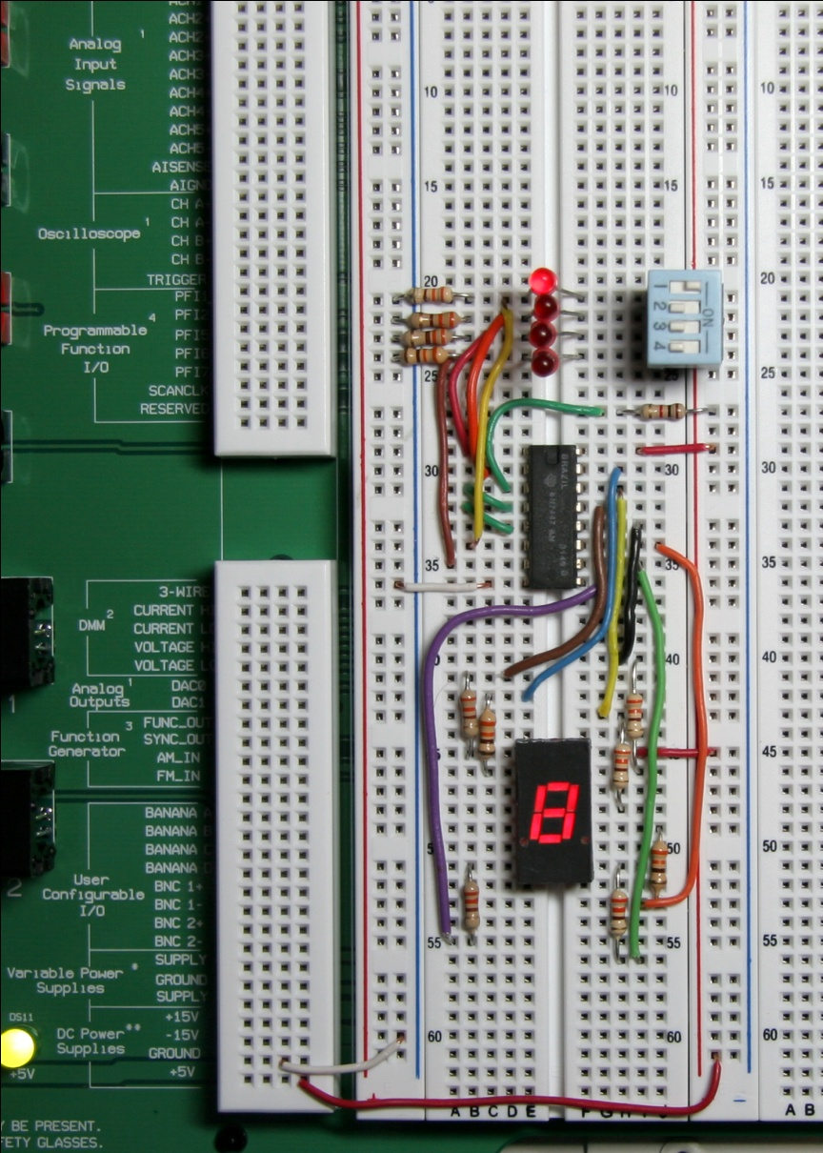
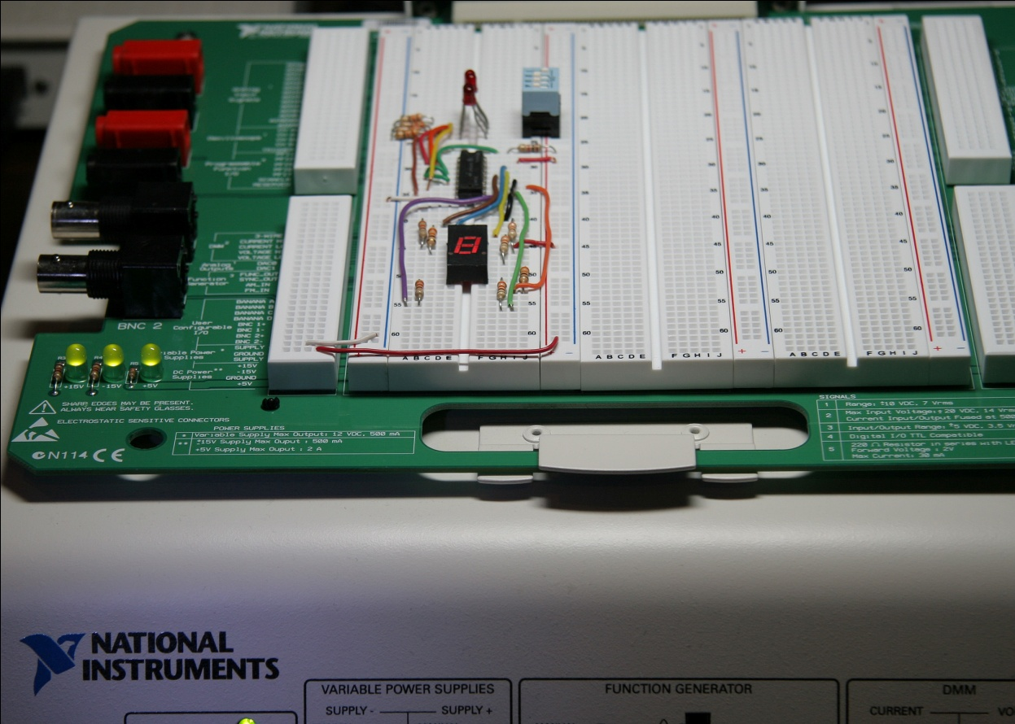
Summary
BCD
A lab experiment in which BCD is converted to decimal is shown.

Slide 14
Summary
Decimal
Binary
Gray code
Gray code
0 1 2 3 4 5 6 7 8 9 10 11 12 13 1415
0000 0001 0010 0011 0100 0101 0110 0111 1000 1001 1010 1011 1100 1101 1110 1111
0000 0001 0011 0010 0110 0111 0101 0100 1100 1101 1111 1110 1010 1011 1001 1000
Gray code is an unweighted code that has a single bit change between one code word and the next in a sequence. Gray code is used to avoid problems in systems where an error can occur if more than one bit changes at a time.

Slide 15
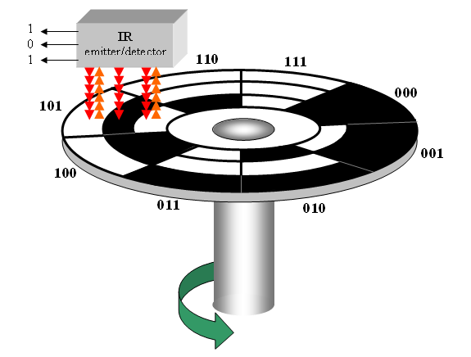
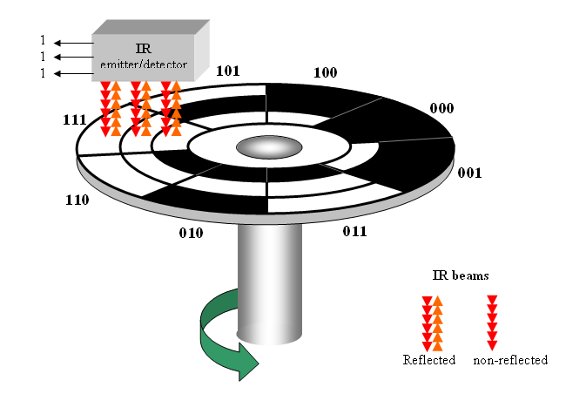
Summary
Gray code
A shaft encoder is a typical application. Three IR emitter/detectors are used to encode the position of the shaft. The encoder on the left uses binary and can have three bits change together, creating a potential error. The encoder on the right uses gray code and only 1-bit changes, eliminating potential errors.
Binary sequence
Gray code sequence

Slide 16
Summary
ASCII
ASCII is a code for alphanumeric characters and control characters. In its original form, ASCII encoded 128 characters and symbols using 7-bits. The first 32 characters are control characters, that are based on obsolete teletype requirements, so these characters are generally assigned to other functions in modern usage.
In 1981, IBM introduced extended ASCII, which is an 8-bit code and increased the character set to 256. Other extended sets (such as Unicode) have been introduced to handle characters in languages other than English.

Slide 17
Summary
Parity Method
The parity method is a method of error detection for simple transmission errors involving one bit (or an odd number of bits). A parity bit is an “extra” bit attached to a group of bits to force the number of 1’s to be either even (even parity) or odd (odd parity).
Example
The ASCII character for “a” is 1100001 and for “A” is 1000001. What is the correct bit to append to make both of these have odd parity?
Solution
The ASCII “a” has an odd number of bits that are equal to 1; therefore the parity bit is 0. The ASCII “A” has an even number of bits that are equal to 1; therefore the parity bit is 1.

Slide 18
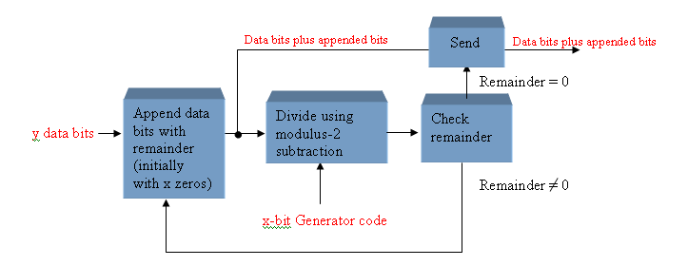
Summary
Cyclic Redundancy Check
The cyclic redundancy check (CRC) is an error detection method that can detect multiple errors in larger blocks of data. At the sending end, a checksum is appended to a block of data. At the receiving end, the check sum is generated and compared to the sent checksum. If the check sums are the same, no error is detected.

Slide 19
Selected Key Terms
Byte
Floating-point number
Hexadecimal
Octal
BCD
A group of eight bits
A number representation based on scientific notation in which the number consists of an exponent and a mantissa.
A number system with a base of 16.
A number system with a base of 8.
Binary coded decimal; a digital code in which each of the decimal digits, 0 through 9, is represented by a group of four bits.

Slide 20
Selected Key Terms
Alphanumeric
ASCII
Parity
Cyclic redundancy check (CRC)
Consisting of numerals, letters, and other characters
American Standard Code for Information Interchange; the most widely used alphanumeric code.
In relation to binary codes, the condition of evenness or oddness in the number of 1s in a code group.
A type of error detection code.

